Slide 1
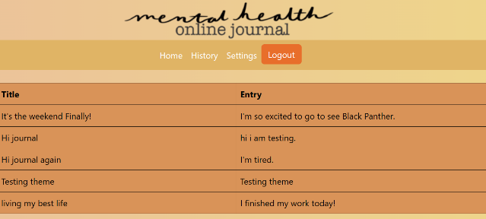
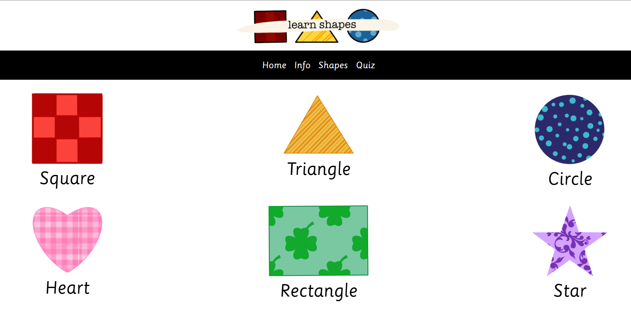
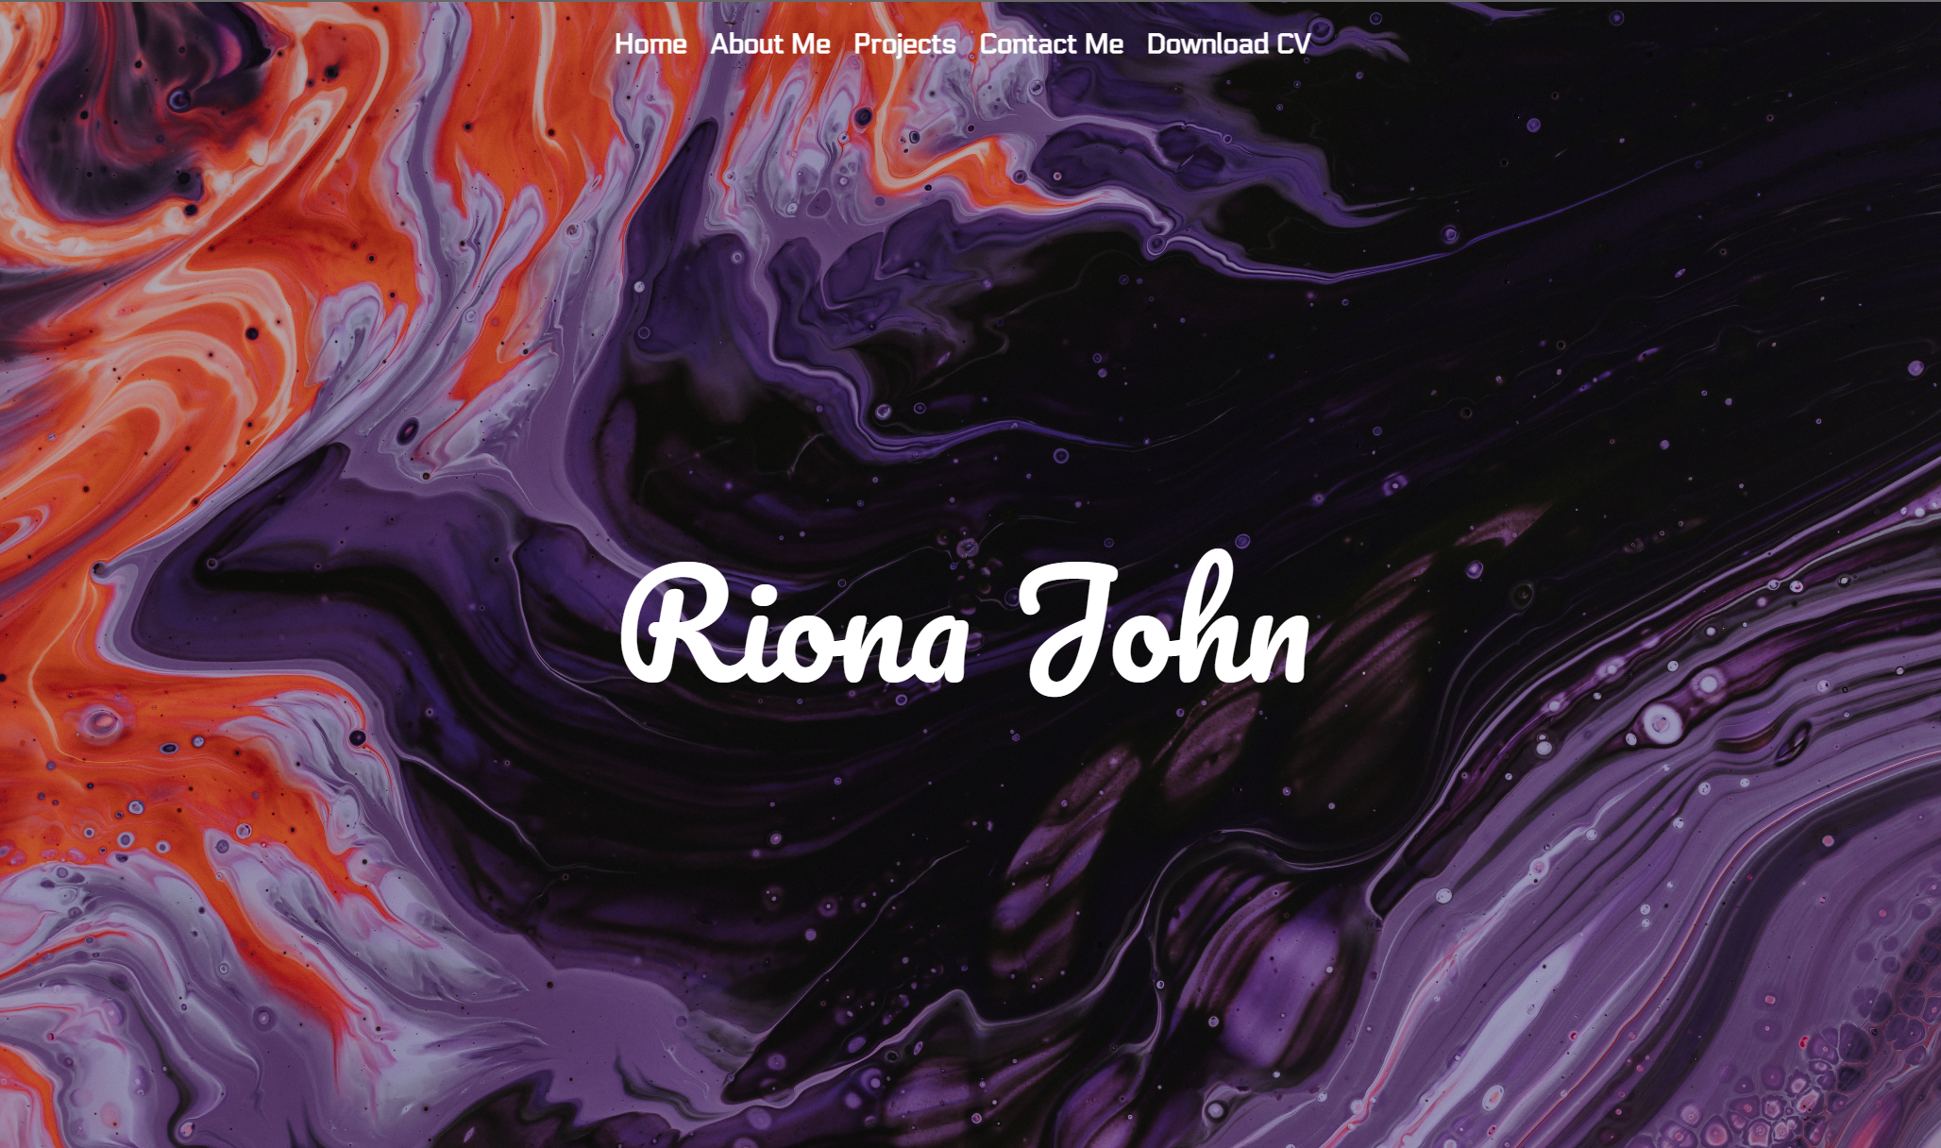
A Study of Human Computer Interaction
Project Overview
Mental Health Online Journal
A Parent-Guided Shape Learning Tool
A Personal Portfolio
Deliverables
Riona John | Zhaohui Luo | Royal Holloway, University of London

